Slide 1


HandsOn Session Python Project

Slide 2

Kurnia Anwar Ra’if
A Highly-motivated Data Scientist
Senior Data & AI Platform - PT. Mastersystem Infotama Tbk
Data Scientist @ PT. KitaLulus International
Data Scientist @ PT. Sharing Vision– BRI Consultant
Software Engineering @ PT. AILIMA Geothermal
Mentor DS/BI/AI-ML - @ Dibimbing.id

Slide 3

Outline :
Refreshment
Flowchart
Mini App - HandsOn

Slide 4
Refreshment

Slide 5
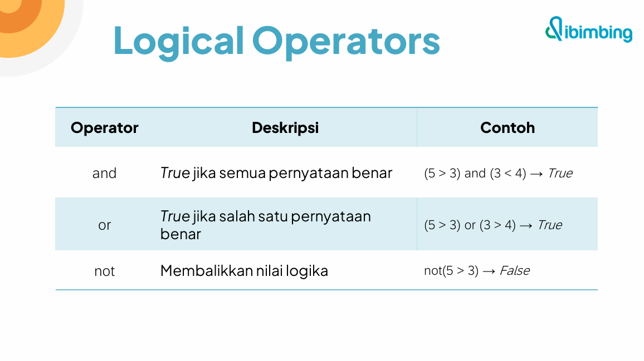

Slide 6

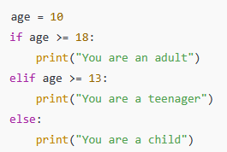
Conditional Statements (if, elif, else)
The if statement checks whether a condition is True. If it is, the indented block of code under it will be executed.
elif (else if) Used to check another condition if the previous if condition was False. You can have multiple elif blocks.
The else block is executed when none of the previous conditions are True.
Summary :
- if: checks the first condition
- elif: checks additional conditions
- else: runs if none of the above conditions are true
These are essential for building decision-making logic in your Python programs.

Slide 7
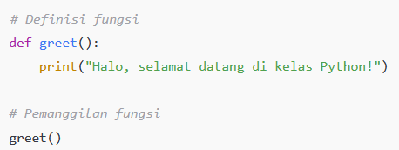
Defining and calling functions
Function adalah blok kode yang dirancang untuk menjalankan tugas tertentu. Function juga bisa disebut method().
Tujuan utama: mengurangi pengulangan kode, mempermudah perawatan, dan meningkatkan keterbacaan.
Dalam Python, fungsi didefinisikan menggunakan def

Slide 8
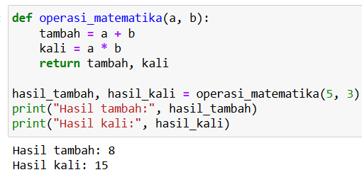
Parameters and Return
Multiple parameters & return multiple values

Slide 9
Flowchart

Slide 10
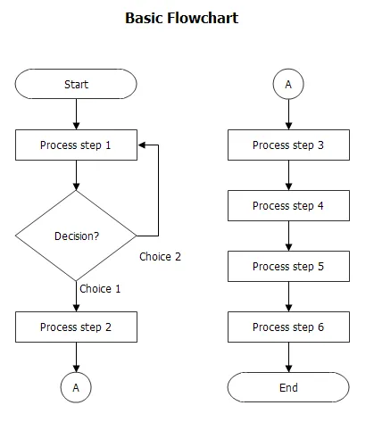
Flowchart
https://medium.com/dot-intern/jenis-flowchart-dan-simbol-simbolnya-ef6553c53d73

Slide 11
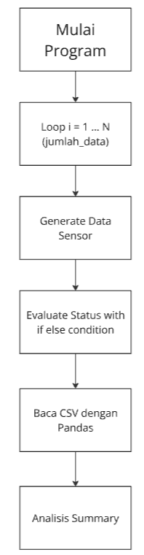
Flowchart : Mini App
https://medium.com/dot-intern/jenis-flowchart-dan-simbol-simbolnya-ef6553c53d73

Slide 12
Hands on

Slide 13


Thank you
https://www.linkedin.com/in/anwaraif/
kurniafreelancer@gmail.com

